Slide 1
CloudBees Jenkins Platform Workflow with Docker

Slide 2
Agenda (Day 1)
Workflow 101
Agenda (Day 2)
Docker 101
Agenda (Day 3)
The Project
Agenda (Day 4)
Bring Your Own Project

Slide 3
Workshop Prerequisites
Git (https://git-scm.com/), VirtualBox (https://www.virtualbox.org/) and Vagrant (https://www.vagrantup.com/) should be installed.
Run the following commands (you will be asked to open Jenkins and add the licence keys):
git clone https://github.com/vfarcic/jenkins-docker-showcase.git cd jenkins-docker-showcase vagrant up cje node-1 node-2 node-3 vagrant ssh cje -c "chmod +x /vagrant/scripts/*" vagrant ssh cje -c "ansible-playbook /vagrant/ansible/cje.yml -c local --extra-vars 'skip_licence=true'" vagrant ssh cje -c "/vagrant/scripts/preload_cje.sh" vagrant ssh cje -c "ansible-playbook /vagrant/ansible/node.yml -i /vagrant/ansible/hosts/dev" # Answer "yes" when asked vagrant ssh cje -c "ansible-playbook /vagrant/ansible/nginx.yml -i /vagrant/ansible/hosts/dev" vagrant ssh node-1 -c "/vagrant/scripts/preload_node.sh" vagrant ssh node-2 -c "/vagrant/scripts/preload_node.sh" vagrant ssh node-3 -c "/vagrant/scripts/preload_node.sh" vagrant halt

Slide 4
Workflow with Docker Day 1
Workflow 101

Slide 5
The Need For Workflow?

Slide 6
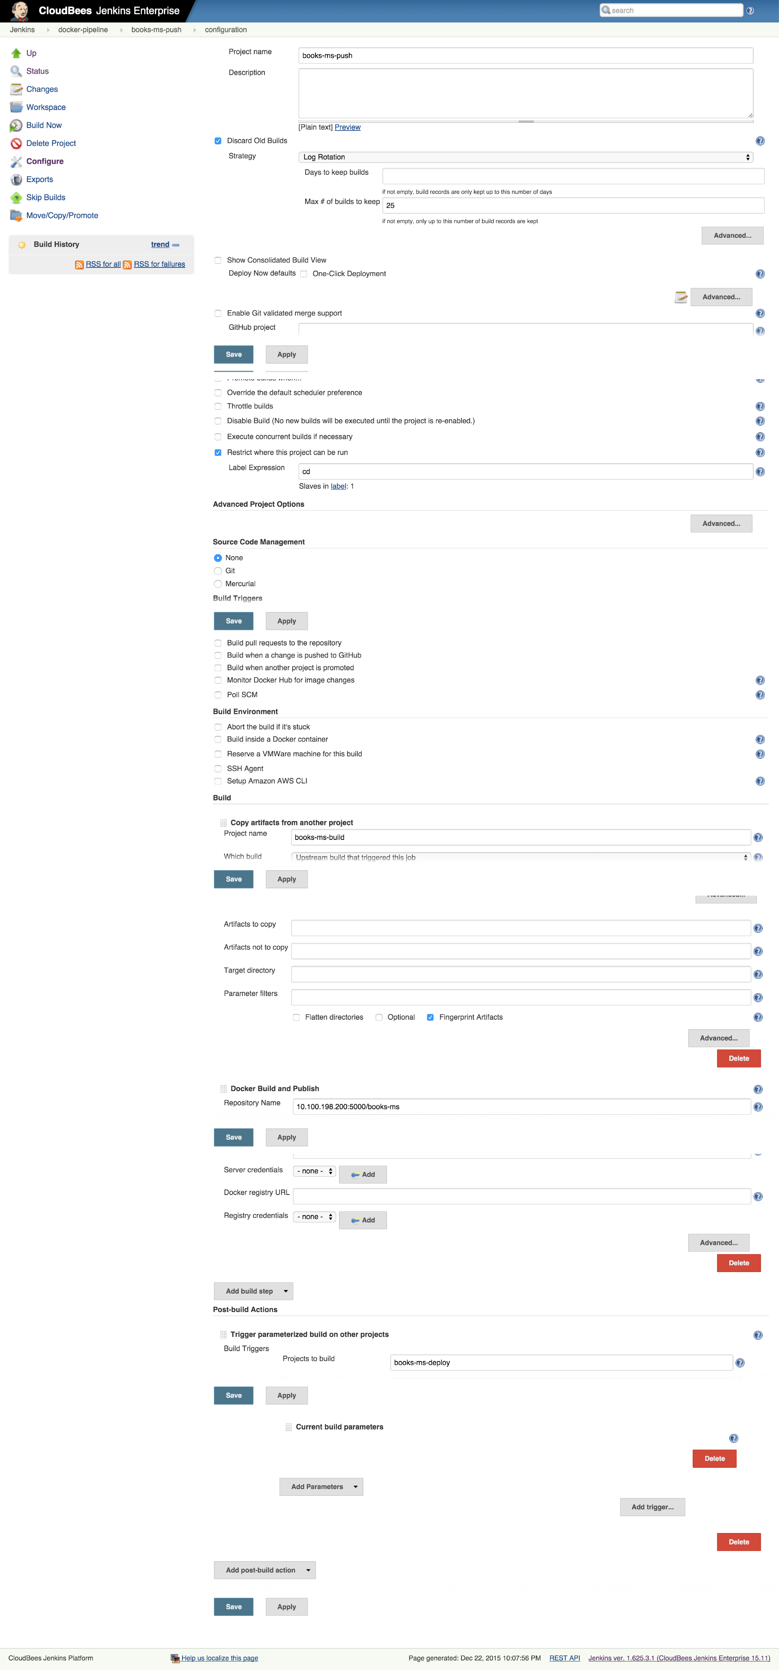
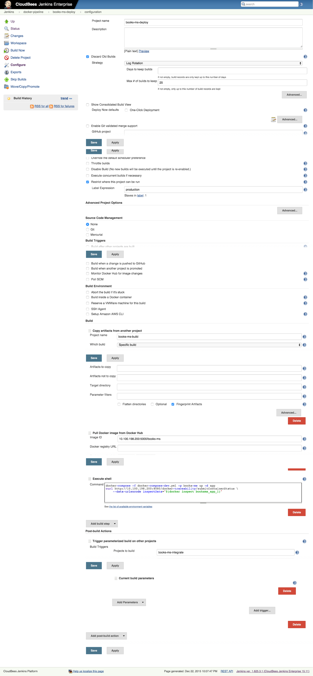
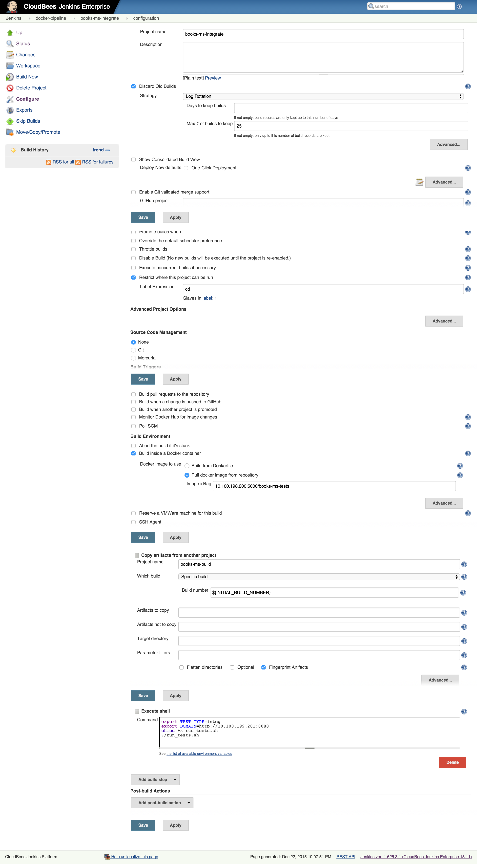
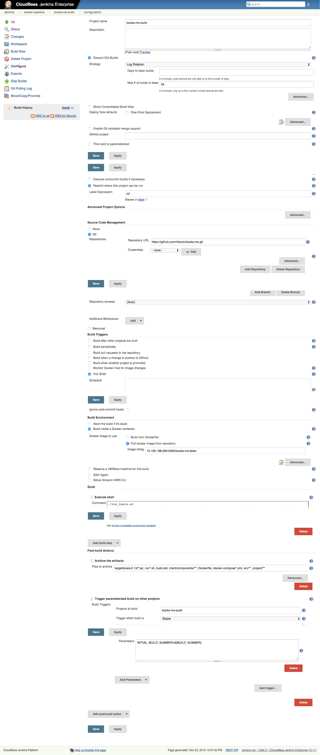
The Need For Workflow
node("cd") { def dir = pwd() git “https://github.com/cloudbees/my-service.git”
stage "pre-deployment tests" def tests = docker.image(“my-service-tests”) tests.pull() tests.inside() { sh "./run_tests.sh" } stage "build" def service = docker.build “my-service" service.push() stash includes: "docker-compose.yml", name: "docker-compose" } node("production") { stage "deploy" unstash "docker-compose" def service = docker.image("${registryIp}/${serviceName}") service.pull() sh "docker-compose -f docker-compose-dev.yml -p ${serviceName} up -d app" } node("cd") { stage "post-deployment tests" def tests = docker.image("${registryIp}/${serviceName}-tests") tests.inside() { withEnv(["TEST_TYPE=integ", "DOMAIN=http://${productionIp}:8080"]) { sh "./run_tests.sh" } } }

Slide 7
What is Workflow?

Slide 8
What is Jenkins Workflow
CD is about setting a “pipeline”, from SCM commit to deployed application
Jenkins can chain jobs this way, but ...
Build
Test
Deploy

Slide 9
Jenkins CD pipeline
a real world CD pipeline is way more complex !
requires (complex) conditional logic
requires resources allocation and cleanup
involves human interaction for manual approval
should be resumable at some point on failure

Slide 10
Jenkins CD pipeline
many related plugins
conditional build steps
parameterized trigger
promotions
...
Major issue : pipeline configuration is scattered in various jobs

Slide 11
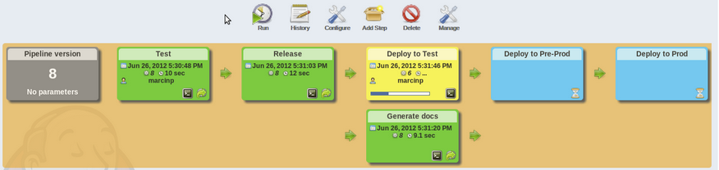
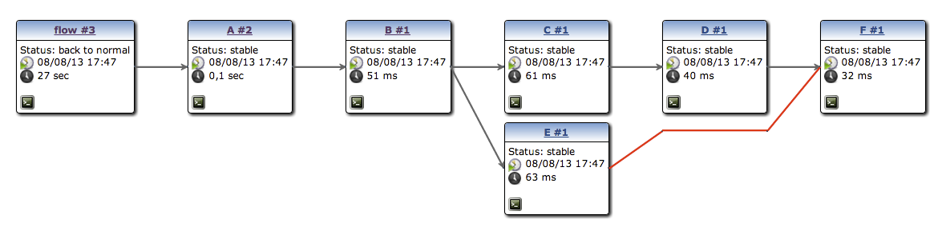
CD pipeline visualization
pipeline plugin to render “linear” pipeline
build-graph-view to render complex ones

Slide 12
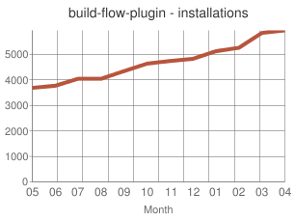
build-flow plugin
OSS, considered a proof of concept
define CD pipeline as (possibly complex) job orchestration written with a Groovy DSL
largely adopted
demonstrates direction is correct
But major technical limitations

Slide 13
CloudBees Workflow Plugin
inspired by build-flow
Groovy DSL to orchestrate build steps (optionally jobs)
extensible DSL syntax
do supports checkpoints
advanced visualization
plain text : Can be stored in SCM
Notes:
Visiualization is available only in the enterprise edition, no Team (opensource).
Also enterprise only is Check.points

Slide 14
Workflow Use Cases

Slide 15
Groovy DSL ?
Groovy based “Domain Specific Language” to manage build step orchestration
Groovy is widely used in Jenkins ecosystem. You can leverage on Groovy experience
If you don’t like/care about Groovy, just consider the DSL as a dedicated simple syntax
Notes:
Need to have very little Groovy knowledge. Just be able to identify and coopy/past code snippets etc.
Lots of flex, little coding needed. Can also store you code and workflow esigns

Slide 16
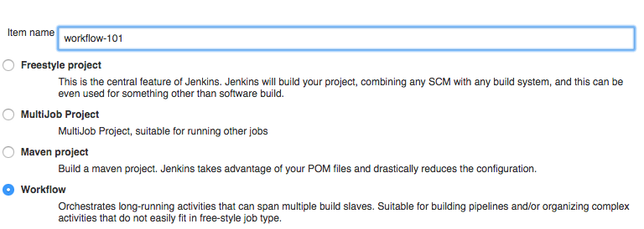
Workflow 101
a Workflow is a new type of job
Notes:
Step 1 – create new workflopw

Slide 17
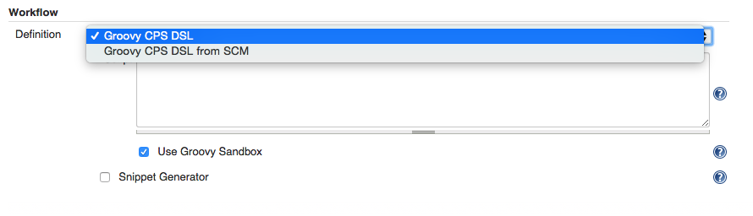
Workflow 101
Can define DSL in jenkins, or store in SCM
=> possibly distinct workflow per branch
no need to be an administrator
no need to know groovy or DSL syntax
Notes:
SCM = source control manager
Tick Snippet Generator to limit need for Groovy.

Slide 18
Workflow Structure and Syntax

Slide 19
Workflow 101 - basic DSL syntax
DSL is used to define when/how to run build steps
those (most of them) will run on a node, i.e. a build executor
node('slave') { sh 'echo hello world' }
DSL keyword to run a shell script build step
Notes:
“node” doesn’t exist in Groovy – it is a DSL

Slide 20
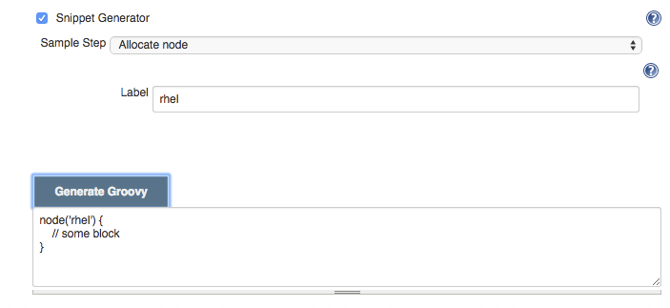
Workflow Snippet Generator
No need to learn DSL syntax !
Notes:
First line odf groovy script.
Using Groovey sandbox and this snippet generator makes this as easy as ppossible.

Slide 21
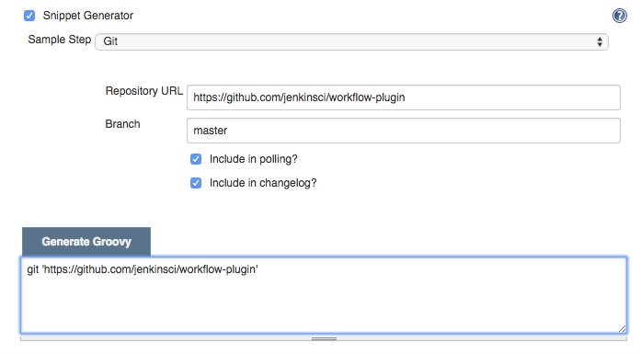
Workflow 101 - build steps
Some have native DSL support
Notes:
Snippet wiz creates the groovy for you

Slide 22
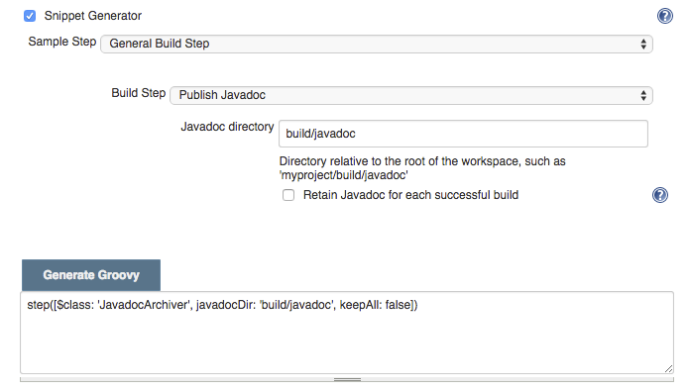
Workflow 101 - build steps
Some don’t (yet) have native DSL support and require some hack-ish invocation syntax - but still work

Slide 23
invocation syntax
step(
[
$class: 'build_step_class_name',
constructor_argument: 'value',
constructor_argument_2: 'value'
]
)
Most build steps can be used this way today, they may evolve to offer native workflow support
DSL keyword to invoke arbitrary step
Same as in job’s config.xml on disk
groovy map

Slide 24
Workflow with Docker Day 2
Docker 101

Slide 25
Prepare the Environments
vagrant up cje node-1 node-2 node-3
vagrant ssh cje
ansible-playbook /vagrant/ansible/node.yml -i /vagrant/ansible/hosts/dev
ansible-playbook /vagrant/ansible/docker.yml -c local
exit

Slide 26
Docker Containers
Isolated
Immutable
Reliable
Self-sufficient
Scalable

Slide 27
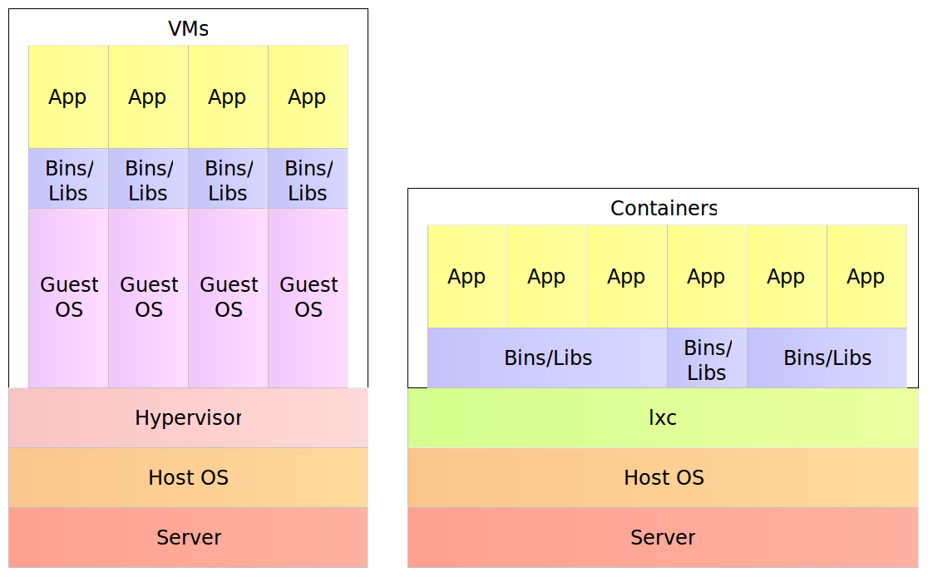
Docker Containers

Slide 28
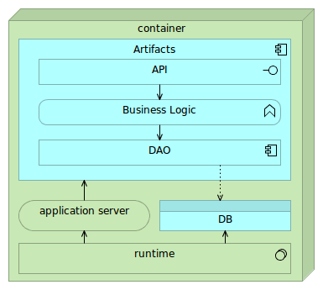
Single-Container Service

Slide 29
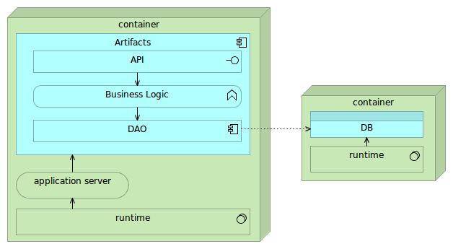
Linked or Networked Containers

Slide 30
Docker Tools
Docker Hub/Registry
Docker Engine
Docker Compose
Docker Swarm
Docker Machine
Kinematic

Slide 31

Docker Hub and Registry
Docker Hub is a cloud hosted service from Docker that provides registry capabilities for public and private content.
Docker Trusted Registry allows you to store and manage your Docker images on-premise or in your virtual private cloud to support security or regulatory compliance requirements in keeping data and applications your infrastructure.
Docker Registry is an open source application dedicated to the storage and distribution of your Docker images.

Slide 32
Docker Hub/Registry
$ vagrant ssh cje
$ docker pull vfarcic/books-ms-tests
$ docker tag vfarcic/books-ms-tests 10.100.198.200:5000/books-ms-tests
$ docker push 10.100.198.200:5000/books-ms-tests

Slide 33

Docker Engine
Docker Engine is a lightweight runtime and robust tooling that builds and runs Docker containers.

Slide 34
Docker Engine - Running Containers
$ cd ~/books-ms
$ docker run -it --rm \
-v $PWD/client/components:/source/client/components \
-v $PWD/client/test:/source/client/test \
-v $PWD/src:/source/src \
-v $PWD/target/scala-2.10:/source/target/scala-2.10 \
--env TEST_TYPE=all \
10.100.198.200:5000/books-ms-tests
$ ll target/scala-2.10/

Slide 35
Docker Engine - Building Containers
$ cat Dockerfile
$ docker build -t 10.100.198.200:5000/books-ms .
$ docker push 10.100.198.200:5000/books-ms

Slide 36
Docker Engine - Running Containers
$ docker run -d --name books-ms-db mongo
$ docker run -d --name books-ms \
-p 1234:8080 \
--link books-ms-db:db \
10.100.198.200:5000/books-ms
$ docker ps
$ curl -I localhost:1234/api/v1/books

Slide 37
Docker Engine - Logs, Processes, Stopping and Removing
$ docker logs books-ms
$ docker logs books-ms-db
$ docker ps
$ docker stop books-ms-db books-ms
$ docker ps -a
$ docker rm books-ms-db books-ms
$ docker ps -a

Slide 38

Docker Compose
Docker Compose allows defining multi-container application with all of its dependencies in a single file, then spin your application up in a single command.

Slide 39
Docker Compose
$ cat docker-compose-dev.yml
$ docker-compose -f docker-compose-dev.yml run --rm tests
$ docker-compose -f docker-compose-dev.yml up -d app
$ docker-compose ps
$ docker-compose logs # Press CTRL+c to exit
$ docker-compose stop
$ docker-compose ps
$ docker-compose rm -f
$ docker-compose ps

Slide 40
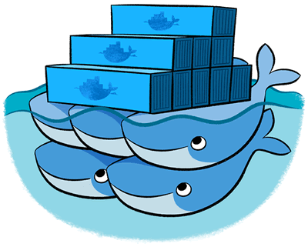
Docker Swarm
Docker Swarm provides native clustering capabilities to turn a group of Docker engines into a single, virtual Docker Engine. With these pooled resources, you can scale out your application as if it were running on a single, huge computer.

Slide 41
Docker Swarm
$ export DOCKER_HOST=tcp://10.100.199.201:2375
$ docker info
$ docker-compose -f docker-compose-swarm.yml pull db app
$ docker-compose --x-networking -f docker-compose-swarm.yml up -d db app
$ docker ps -a | grep books
$ docker-compose --x-networking -f docker-compose-swarm.yml scale app=3
$ docker ps -a | grep books
$ docker-compose -f docker-compose-swarm.yml stop
$ docker-compose -f docker-compose-swarm.yml rm -f

Slide 42

Docker Machine
Docker Machine automatically sets up Docker on your computer, on cloud providers, and inside your data center. Docker Machine provisions the hosts, installs Docker Engine on them, and then configures the Docker client to talk to the Docker Engines.

Slide 43
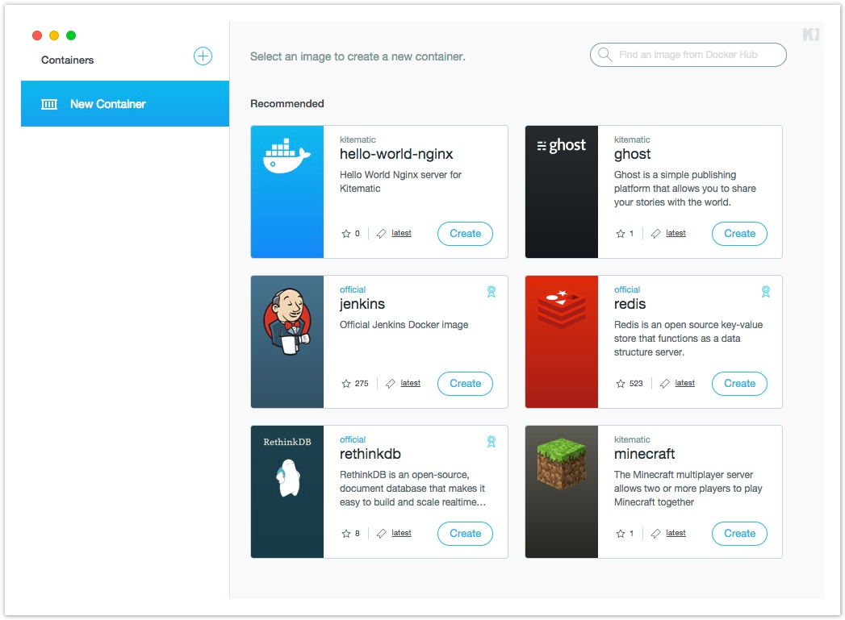
Kitematic
Kitematic is a completely automated process that installs and configures the Docker environment on your machine. Build and run containers through a simple, yet powerful graphical user interface (GUI).

Slide 44
Cleanup
$ exit
$ vagrant halt

Slide 45
Workflow with Docker Day 3
The Project

Slide 46
Prepare the Environments
vagrant up cje node-1 node-2 node-3
vagrant ssh cje
ansible-playbook /vagrant/ansible/node.yml -i /vagrant/ansible/hosts/dev
ansible-playbook /vagrant/ansible/cje.yml -c local

Slide 47
The Project
Run pre-deployment tests (unit tests, functional tests, and so on) inside a Docker container
Build artefacts (JAR, WAR, DLL, and so on)
Build the service container
Request manual permission to deploy the service container to production
Pull the service container and all dependant containers to production
Run the service container and all dependant containers in production
Run post-deployment tests (integration tests) inside a Docker container

Slide 48
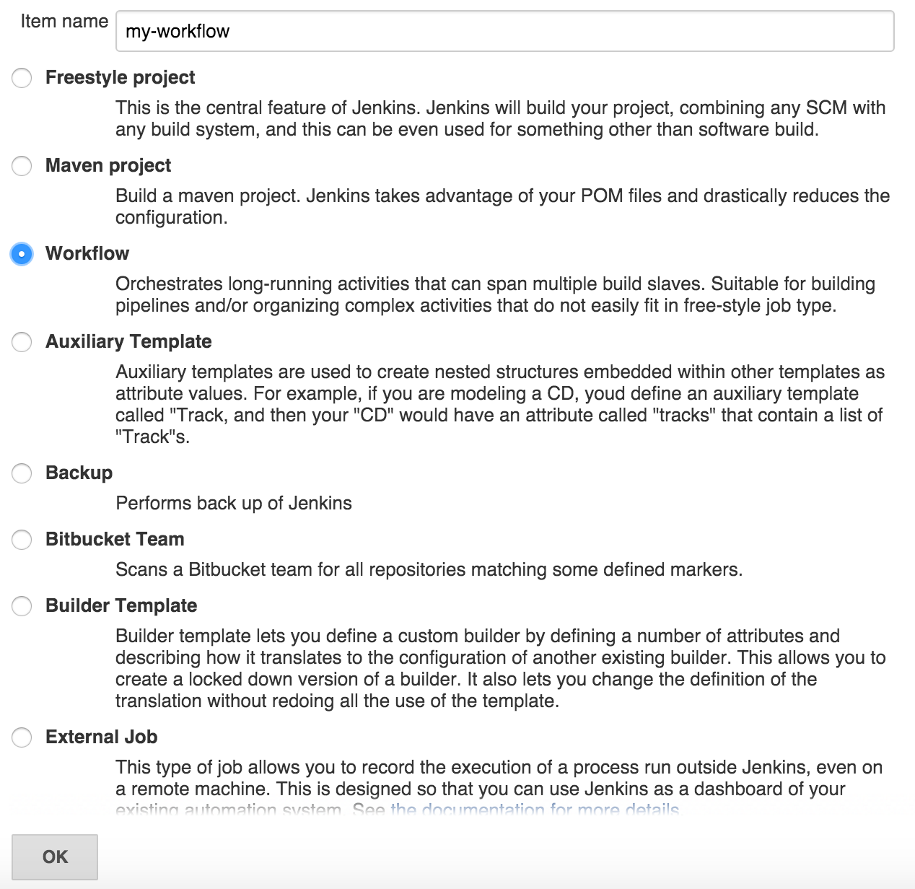
Create a Workflow Job

Slide 49
Key Workflow DSL – node
A node is a step that schedules a task to run by adding it to the Jenkins build queue.
As soon as an executor slot is available on a node (the Jenkins master, or a slave), the task is run on that node.
A node also allocates a workspace (file directory) on that node for the duration of the task (more on this later).
node('node_name_or_label') {
// some code
}

Slide 50
Key Workflow DSL – node
Task:
Specify the node cd, run the workflow and confirm that it is running inside the cd node by looking at logs.
node("cd") {
}

Slide 51
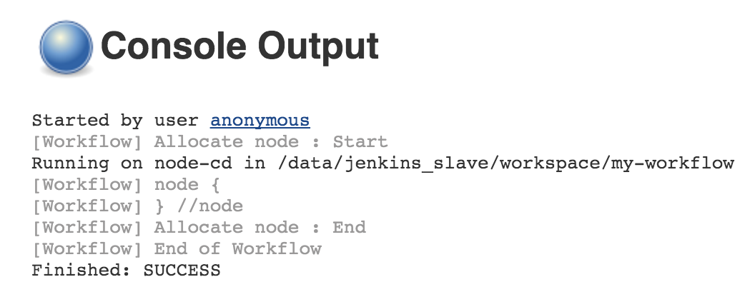
Run the Job
Open http://10.100.198.200:8080/job/my-workflow/build?delay=0sec
Open http://10.100.198.200:8080/job/my-workflow/lastBuild/console

Slide 52
Key Workflow DSL – git
The git step lets you define a repository to clone. For authentication, a reference to a configured credential can be passed.
git url: 'git@git.local.domain:ps/project.git', credentialsId: '67c3072d-b9a7-44fa-a5aa-560ba9c1662f'

Slide 53
Key Workflow DSL – git
Task:
Clone the code from the repository https://github.com/vfarcic/books-ms.git
git "https://github.com/vfarcic/books-ms.git"

Slide 54
Key Workflow DSL – variables, pwd and sh
TODO

Slide 55
Key Workflow DSL – variables, pwd and sh
Task:
Assign current job workspace directory to the dir variable, create directory db inside the workspace and assign full permissions to all users.
def dir = pwd()
sh "mkdir -p ${dir}/db”
sh "chmod 0777 ${dir}/db"

Slide 56
Key Workflow DSL – stage
TODO

Slide 57
Key Workflow DSL – stage
Task:
Create the pre-deployment tests stage.
stage "pre-deployment tests"

Slide 58
Key Workflow DSL – docker
TODO

Slide 59
Key Workflow DSL – docker
Task:
Pull the Docker image 10.100.198.200:5000/books-ms-tests and run the run_tests.sh script inside the container. Host volume db should be shared with /data/db inside the container.
def tests = docker.image("10.100.198.200:5000/books-ms-tests")
tests.pull()
tests.inside("-v ${dir}/db:/data/db") {
sh "./run_tests.sh"
}

Slide 60
Key Workflow DSL – docker
Task:
Build the Docker image 10.100.198.200:5000/books-ms and push the container to the private registry. Use the stage build for these steps
stage "build"
def service = docker.build "10.100.198.200:5000/books-ms"
service.push()

Slide 61
Key Workflow DSL – stash and unstash
TODO

Slide 62
Key Workflow DSL – stash and unstash
Task:
Pull containers and run (through docker-compose-dev.yml and target app) the 10.100.198.200:5000/books-ms container in the production node. Use stash to archive docker-compose-dev.yml file while in the cd node and unstash to retrieve it when inside the production node.
node("cd") {
...
stash includes: "docker-compose*.yml", name: "docker-compose"
}
node("production") {
stage "deploy"
unstash "docker-compose"
docker.image("10.100.198.200:5000/books-ms").pull()
docker.image("mongo").pull()
sh "docker-compose -f docker-compose-dev.yml -p books-ms up -d app"
}

Slide 63
Key Workflow DSL – env and withEnv
TODO

Slide 64
Key Workflow DSL – env and withEnv
Task:
Run post-deployment tests in the node cd. The run_tests.sh script expects two environment variables: TEST_TYPE=integ and DOMAIN=http://10.100.199.201:8080.
node("cd") {
stage "post-deployment tests"
def tests = docker.image("10.100.198.200:5000/books-ms-tests")
tests.inside() {
withEnv(["TEST_TYPE=integ", "DOMAIN=http://10.100.199.201:8080"]) {
sh "./run_tests.sh"
}
}
}

Slide 65
Key Workflow DSL – input
TODO

Slide 66
Key Workflow DSL – input
A real world CD pipeline involves human interaction
manual validation steps
approval
Jenkins users used to rely on Promoted Builds Plugin
but then lost the “pipeline execution flow” view

Slide 67
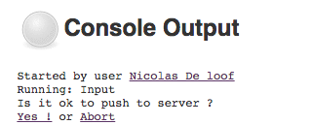
Key Workflow DSL – input
DSL keyword for interactive step
input
message: 'Is it ok to deploy ?',
ok: 'Yes!',
submitter: 'boss'
Button caption
Role restriction
Notes:
Input is the command for interaction, then specify what you want to have user do i.e. approve something.

Slide 68
Key Workflow DSL – input
Task:
Add an input with the message Please confirm deployment to production and button with the text I Confirm prior to deployment to production.
input message: "Please confirm deployment to production", ok: "I confirm"

Slide 69
Key Workflow DSL – parallel
TODO

Slide 70
Key Workflow DSL – parallel
Task:
Change the script so that service and db containers are pulled in parallel.
docker.image("10.100.198.200:5000/books-ms").pull()
docker.image(“mongo”).pull()
def pull = [:]
pull["service"] = {
docker.image("10.100.198.200:5000/books-ms").pull()
}
pull["db"] = {
docker.image("mongo").pull()
}
parallel pull

Slide 71
Key Workflow DSL – execution control
wait for event
waitUntil {
// some block
}
timeout
timeout(time: 100,
unit: 'SECONDS') {
// some block
}
try up to N times
retry(10) {
// some block
}
pause
sleep time: 10,
unit: 'MINUTES'
You can also rely on Groovy control flow syntax
while(something) {
// do something
if (something_else) {
// do something else
}
}

Slide 72
Key Workflow DSL – execution control
Task:
Change the script so that the execution of post-deployment tests is retried in case of a failure.
retry(2) {
sh "./run_tests.sh"
}

Slide 73
Key Workflow DSL – execution control
Task:
Change the script so that there is a pause of 2 seconds after the service is deployed.
sleep 2

Slide 74
Key Workflow DSL – checkpoint
Complex workflow may fail due to external causes (test resource offline, etc…)
Restarting from step 1 would be a waste of time and resources
Checkpoints capture the workflow state
Allow to start a new execution from intermediate state

Slide 75
Key Workflow DSL – checkpoint
Task:
Add checkpoint deploy before deployment to production
checkpoint "deploy"

Slide 76
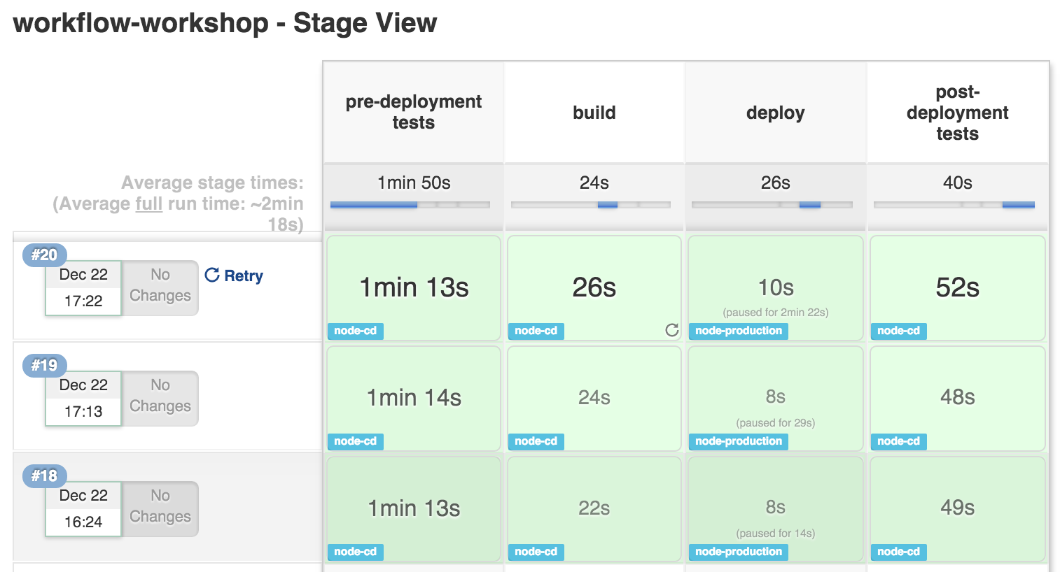
Workflow Stage View
When you have complex builds pipelines, it is useful to be able to see the progress of each stage. To that end, Jenkins Enterprise includes an extended visualization of workflow build history on the index page of a flow project, under Stage View. (You can also click on Full Stage View to get a full-screen view.)
By adding Stage View to your Workflow jobs it allows users to easily identify the progress of each stage within the job.

Slide 77
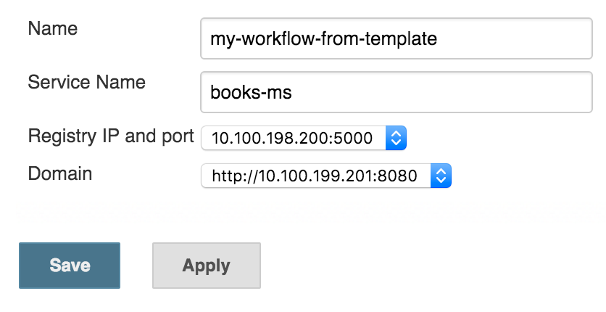
Workflow and Job Template
Task:
Convert the deployment workflow script into a template named my-template.
Replace service name (books-ms), Registry IP and port (10.100.198.200:5000) and domain (http://10.100.199.201:8080) with variables.
Create a new job called my-workflow-from-template

Slide 78
Workflow with Docker Day 4
Bring Your Own Project

